Slide 1
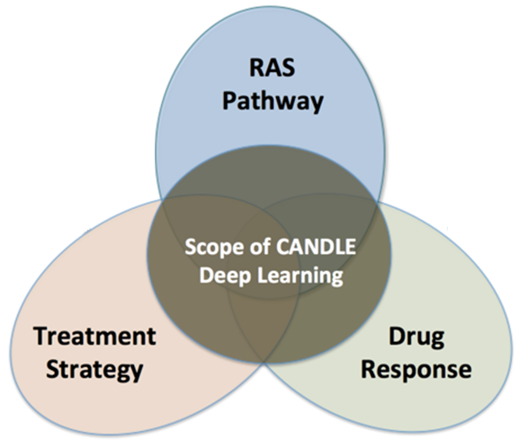
EXAWORKS TUTORIAL: Swift/T
LEARNING WORKFLOWS On EXASCALE computers
erhtjhtyhy
Justin M Wozniak
Computer Scientist
Data Science & Learning
Argonne National Laboratory
ExaWorks Tutorial @ SC
November 15, 2021

Slide 2
OUTLINE
Overview of Swift/T workflow system
Application to Exascale Deep Learning project: CANDLE
Introduction to hyperparameter optimization
Workflow-based solution: EMEWS
Demo of Swift/T

Slide 3
Swift/T OVERVIEW

Slide 4
WORKFLOW support for ML frameworks
Concurrency:
Very fast task distributor
Intranode concurrency, accelerators left up to the framework
Multinode ML tasks are future work (already basically supported)
Data management:
Input staging methods have been developed
Intermediate caches via DataSpaces
Software integration:
Usually launch frameworks in separate process
Launching within process is a configuration challenge
Search methods launched within process

Slide 5


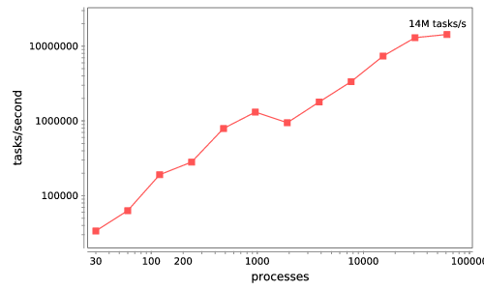






Swift/T: Enabling high-performance Scripted workflows
Supports tasks written in many languages
Write site-independent scripts, translates to MPI
Automatic task parallelization and data movement
Invoke native code, script fragments
Rapidly subdivide large partitions for MPI jobs in multiple ways
Swift/T control process
Swift/T worker
C
C++
Fortran
C
C++
Fortran
MPI
C
C++
Fortran
64K cores of Blue Waters
2 billion Python tasks 14 million Pythons/s
Compiler techniques for massively scalable implicit task parallelism. Proc. SC 2014.
$ conda install -c lightsource2-tag swift-t

Slide 6

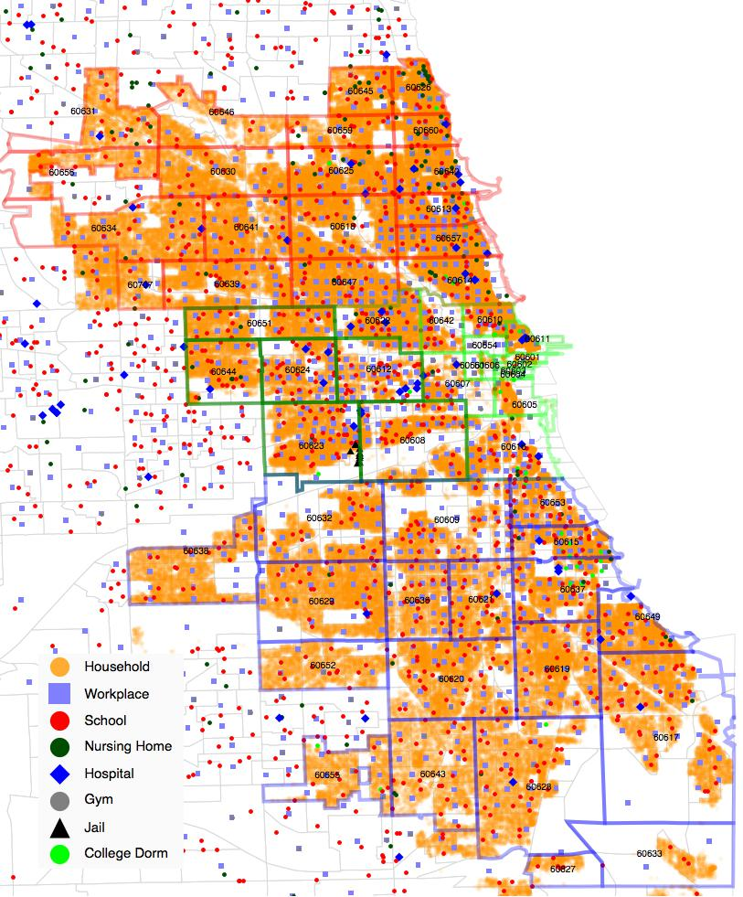
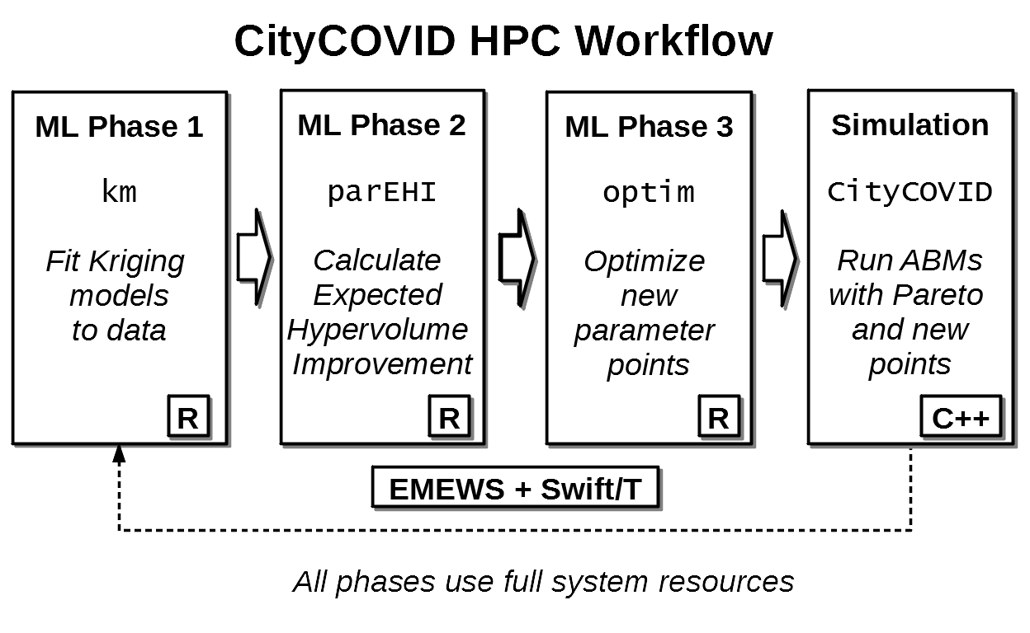
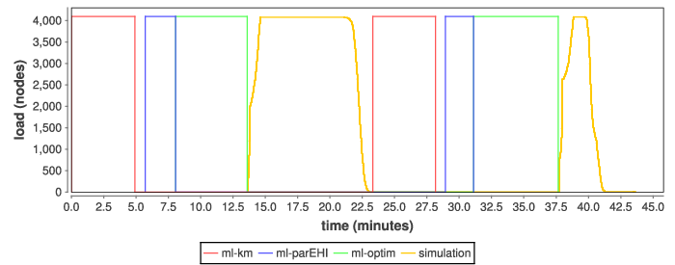
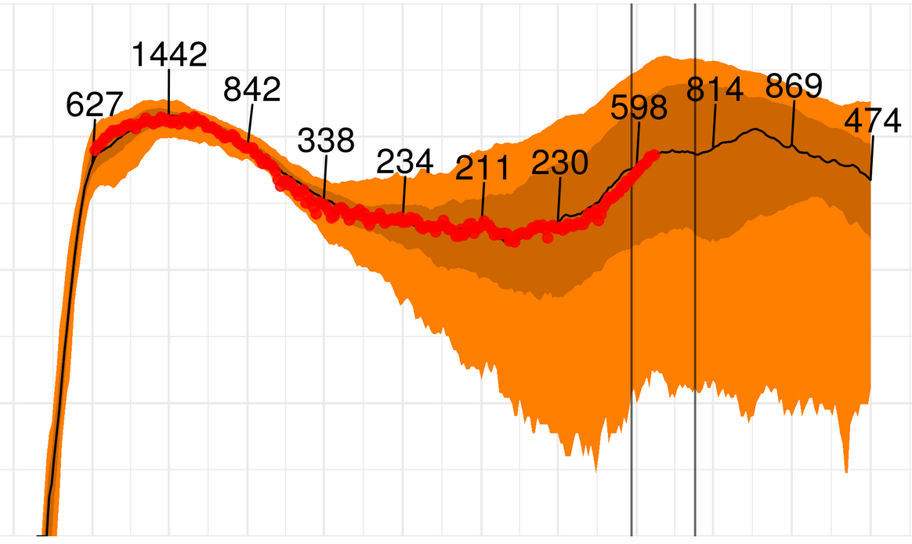
ML-driven workflows for COVID-19 population modeling
Finalist 2020
ML-driven parameter fitting monitored by DB
Large ensemble of RepastHPC-based C++/MPI simulations over 10 million simulated persons, modeling COVID transmission in Chicago
R-based ML libraries (+MKL) propose and evaluate simulation parameters, also using parallel resources, fitting against real-world data reports
Python-based DB API posts results to Postgres for real-time human monitoring from remote sites
Transforms Theta into a data pipeline
Chicago data tables
ML
ML
ML
SIM
ML
ML
ML
SIM
Actionable
epidemiological predictions
A population data-driven workflow for COVID-19 modeling and learning. Collier, Ozik, Wozniak, Macal, and Binois. Int. J. High Perform. Comput. Appl. 2021.
DB
COVID-19 Hospital Beds Over Time

Slide 7
Language goals
Hierarchical, naturally parallel, script-like programming
Make it easy to run large batteries of external program or library executions
Provide rich programming language at the top level – fully generic
Support implicit concurrency and conventional programming constructs
Enable complex tasks based in other scripting languages (e.g., Python) or parallel MPI tasks

Slide 8
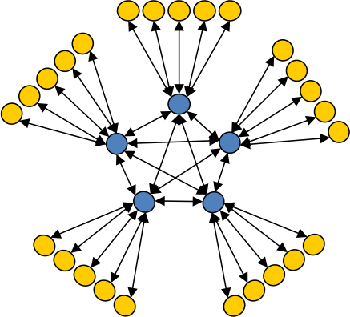
Asynchronous Dynamic Load Balancer
workers
ADLB for short
An MPI library for master-worker workloads in C
Uses a variable-size, scalable network of servers
Servers implement work-stealing
The work unit is a byte array
Optional work priorities, targets, types
For Swift/T, we added:
Server-stored data
Data-dependent execution
masters
Lusk et al. More scalability, less pain: A simple programming model and its implementation for extreme computing. SciDAC Review 17, 2010

Slide 9

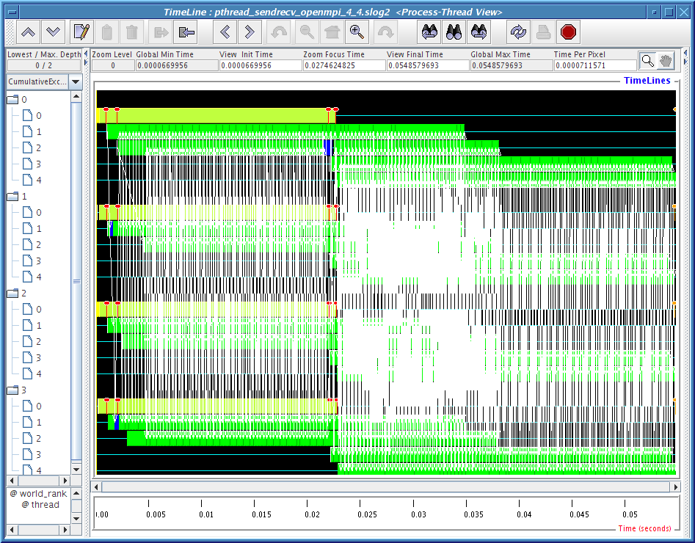
MPI: The Message Passing Interface
Programming model used on large supercomputers
Can run on many networks, including sockets, or shared memory
Standard API for C and Fortran; other languages have working implementations
Contains communication calls for
Point-to-point (send/recv)
Collectives (broadcast, reduce, etc.)
Interesting concepts
Communicators: collections of communicating processing and a context
Data types: Language-independent data marshaling scheme

Slide 10
Extreme-scale model exploration with Swift (EMEWS)

Slide 11
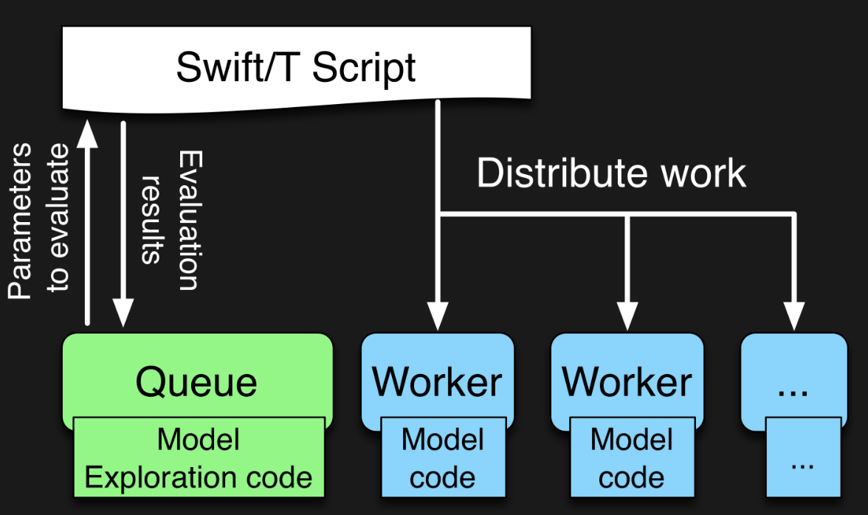

EMEWS workflow structure
The core novel contributions of EMEWS are shown in green, these allow the Swift script to access a running Model Exploration (ME) algorithm, and create an inversion of control (IoC) workflow
Both green and blue boxes accept existing multi-language code

Slide 12
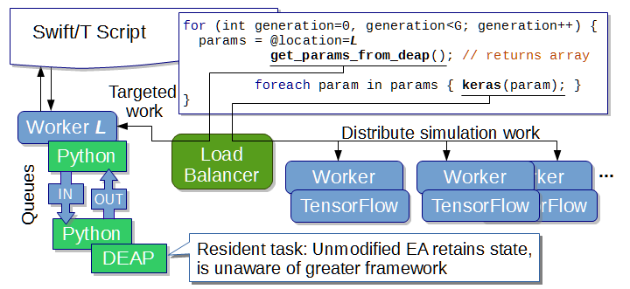
EMEWS: Extreme-scale model exploration workflows in Swift/T
To query the state of the EA, we designate one worker on location L for exclusive use by DEAP.
http://www.mcs.anl.gov/~emews/tutorial

Slide 13
CANDLE workflows: Goals
Develop an exascale deep learning environment for cancer
Building on open source deep learning frameworks and middleware
Optimization for CORAL and exascale platforms
Support all three pilot project needs for deep learning – common abstractions
Collaborate with DOE computing centers, HPC vendors and ECP co-design and software technology projects
Mission statement: Enable the most challenging deep learning problems in cancer research to run on the most capable supercomputers in the DOE

Slide 14
CANDLE Software Stack
Hyperparameter Sweeps,
Data Management (e.g. DIGITS, Swift, etc.)
Workflow
Network description, Execution scripting API
(e.g. Keras, Mocha)
Scripting
Tensor/Graph Execution Engine
(e.g. Theano, TensorFlow, LBANN-LL, etc.)
Engine
Architecture Specific Optimization Layer
(e.g. cuDNN, MKL-DNN, etc.)
Optimization

Slide 15







Deep learning on supercomputers
Steep learning curve with myriad technologies
Workflow manager (Swift/T, EMEWS) ; Scheduler ; scripting
Deep learning (Keras, TensorFlow, Horovod)
Optimization algorithms (R, Python)
MPI implementation (MVAPICH, Open MPI)
etc. …

Slide 16
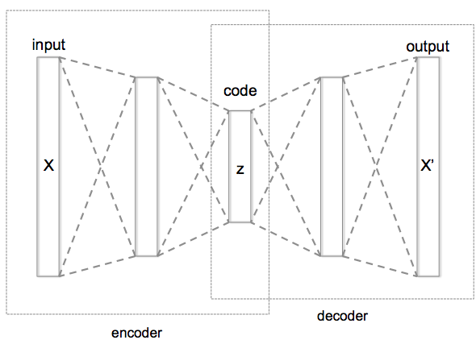
WHAT IS HYPERPARAMETER OPTIMIZATION
Hyperparameter optimization = HPO
Neural networks have a large number of possible configuration parameters, called hyperparameters
Avoids collision with NN weights, which are sometimes called parameters
Applying optimization can automate part of the design of the neural network
In the cancer Pilot 1 autoencoder shown, the system can determine
How many neurons to put in each layer
What activation function to use
What batch size to use
Etc.

Slide 17
Mathematical expression for hpo
For a given problem:
A loss function F is determined on a given NN (usually accuracy)
The hyperparameter optimization problem is to minimize F(p),
for all hyperparameter sets p in the valid parameter space P,
however, P is large and F is expensive.
P is the cross product of all valid network settings,
some of which may be categorical, some integer, some continuous.
Evaluating F involves training the network on a training data set and applying it to the validation set
We can use a generic, previously developed method to optimize F !
These methods require and can use large compute resources

Slide 18
BASIC STRATEGIES
Grid search
Random search
Generic optimization
Stochastic gradient descent
Evolutionary algorithms
Model-based optimization (mlrMBO in R)
NN hyperparameter-specific optimization
Hyperopt, NEAT, Optunity, …

Slide 19
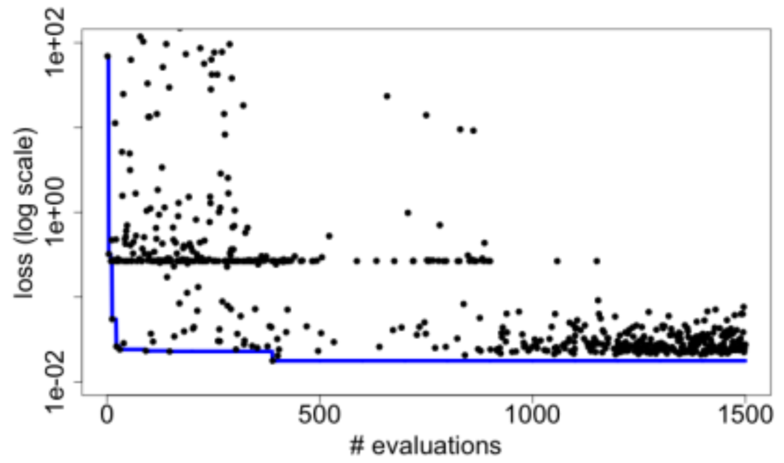
Hyperparameter optimization
Search for the best combination of hyperparameters for a given DL app- neuron counts, functions, etc.
Optimize for validation loss, a measure of error
Use an external R library to perform the optimization
Iteratively receive trial hyperparameters, evaluate them with the obj() function, return results
Algorithm terminates after convergence or iteration limit
CANDLE/Supervisor: A workflow framework for machine learning applied to cancer research. BMC Bioinform. 2018.
for (boolean b = true, int i = 1;
b; b=c, i = i + 1) {
string params = EQR_get(ME);
boolean c;
if (params == "DONE") {
string finals = EQR_get(ME);
c = false;
} else {
string param_array[] = split(params, ";");
string results[];
foreach param, j in param_array {
run_id = "%i_%i_%i" % (restart, i, j);
results[j] = obj(param, run_id);
}
string result = join(results, ";");
EQR_put(ME, result) => c = true;
}
}

Slide 20
The Swift programming model
All progress driven by concurrent dataflow
(int r) myproc (int i, int j)
{
int x = F(i);
int y = G(j);
r = x + y;
}
F() and G() implemented in native code or external programs
F() and G()run in concurrently in different processes
r is computed when they are both done
This parallelism is automatic
Works recursively throughout the program’s call graph

Slide 21
Swift syntax
Data types
int i = 4;
string s = "hello world";
file image<"snapshot.jpg">;
Shell access
app (file o) myapp(file f, int i)
{ mysim "-s" i @f @o; }
Structured data
typedef image file;
image A[];
type protein_run {
file pdb_in; file sim_out;
}
bag<blob>[] B;
Conventional expressions
if (x == 3) {
y = x+2;
s = strcat("y: ", y);
}
Parallel loops
foreach f,i in A {
B[i] = convert(A[i]);
}
Data flow
merge(analyze(B[0], B[1]),
analyze(B[2], B[3]));
Swift: A language for distributed parallel scripting. J. Parallel Computing 2011

Slide 22
DEEP LEARNING WORKFLOWS: CANDLE

Slide 23
Summary of key system points
What about Swift/T enables CANDLE?
A workflow system that is actually a hierarchical programming language
Runs entirely on the compute nodes
Uses standard APIs for HPC (MPI), allows for minimal OS environment
Very scalable
Supports MPI tasks, embedded Python, R interpreters
What about EMEWS enables CANDLE?
Allows user to focus on two sequential codes
The optimizer
Their objective function code
Everything else is managed by the system

Slide 24
Thanks
Thanks to the organizers
Code and guides:
Swift/T Home: http://swift-lang.org/Swift-T
EMEWS Tutorial: http://emews.org
CANDLE GitHub Organization: https://github.com/ECP-CANDLE
This research was supported by the Exascale Computing Project (17-SC-20-SC), a joint project of the U.S. Department of Energy’s Office of Science and National Nuclear Security Administration, responsible for delivering a capable exascale ecosystem, including software, applications, and hardware technology, to support the nation’s exascale computing imperative.

Slide 25
TUTORIALS

